Slide 1


Estimating Fire Radiative Power (FRP) in Forest Fires Using Satellite Data
ARIJIT MANDAL
SRM INSTITUTE OF SCIENCE AND TECHNOLOGY
AICTE Student ID:STU684e91b0f0e8b1749979568
AICTE Internship ID:
INTERNSHIP_17513641056863b20937d78

Slide 2

Learning Objectives
Understand what Fire Radiative Power (FRP) is and why it is important for forest fire monitoring.
Learn how to clean and prepare satellite data for analysis.
Explore the dataset using graphs and find patterns that affect FRP.
Build and test machine learning models (regression and classification) for predicting FRP.
Learn how to save and deploy the model in a simple web app for real use
GOAL
Source :
www.freepik.com/

Slide 3
Tools and Technology used
Programming Language: Python
Framework: Streamlit, Flask (for deployment)
Environment: Google Colab / Jupyter Notebook / VS Code
Dataset: NASA MODIS Satellite Fire Dataset (Turkey Fire Data: 2000–2021)
Libraries:
Data Handling: Pandas, NumPy
Visualization: Matplotlib, Seaborn
Machine Learning: Scikit-learn
Model Saving: Joblib
Version Control: Git & GitHub
Deployment Platform: Streamlit Cloud / Localhost (for hosting the prediction app)

Slide 4
Methodology
Problem Statement – Define the need to estimate Fire Radiative Power (FRP) for monitoring wildfire intensity and emissions.
Data Collection – Use NASA MODIS fire dataset (Turkey, 2000–2021) with brightness, temperature, confidence, scan, track, and FRP values.
Data Preprocessing – Clean dataset, handle missing values, convert date into year/month, and encode day/night.
Exploratory Data Analysis – Plot FRP distribution, scatterplots, trends by year/month, and correlation heatmap.
Model Selection –
Linear Regression → For predicting continuous FRP values.
Logistic Regression → For classifying FRP into intensity levels (Low, Medium, High).
Model Training & Evaluation – Split data into train/test sets, evaluate using MAE, RMSE, R² for regression; confusion matrix and classification report for classification.
Deployment – Save models with Joblib and build a Streamlit app for real-time FRP prediction

Slide 5
Problem Statement:
Forest fires cause severe ecological and economic damage worldwide, leading to loss of biodiversity, destruction of property, and increased carbon emissions. Predicting Fire Radiative Power (FRP) is essential for assessing fire intensity, spread, and emissions. Accurate FRP estimation can support early warning systems, disaster management, emission control, and ecological protection.

Slide 6
Solution:
The project helps in early warning and monitoring by providing quick FRP estimation using Linear Regression, which gives continuous fire intensity values for real-time detection.
I chose Linear Regression because it is simple, efficient, and interpretable, making it suitable for predicting FRP from satellite features with reasonable accuracy.
I also used Logistic Regression to classify FRP into Low, Medium, and High categories, which contributes to easier risk assessment for disaster management teams.
By combining regression and classification models, the project improves disaster management, as both numeric predictions and intensity levels guide resource allocation.
The models contribute to environmental protection by enabling estimation of wildfire emissions and supporting ecological impact studies.
The solution is scalable and practical, as the trained models were deployed in a Streamlit app, making them accessible for non-technical users like forest officers and policy makers.
GitHub Link - https://github.com/Arijit065/Forest-Fire-Fire-Radiative-Power-FRP-Prediction

Slide 7
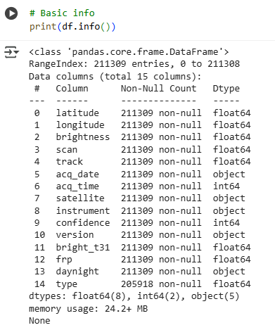
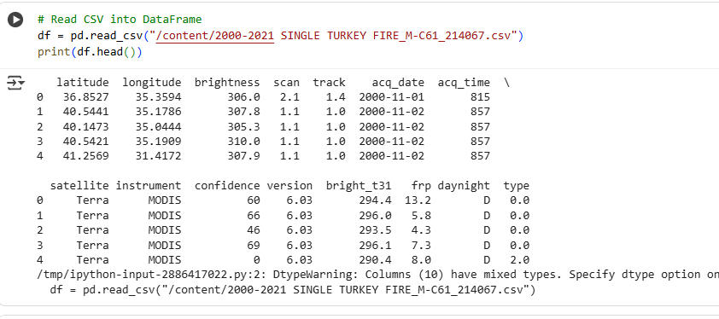
Screenshot of Output:

Slide 8
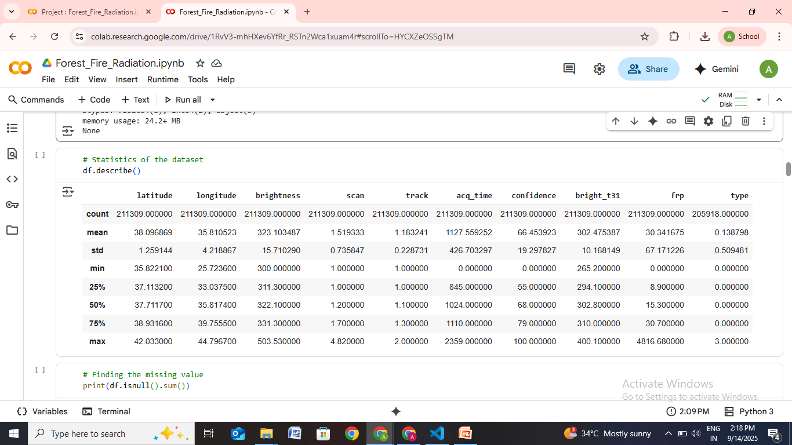
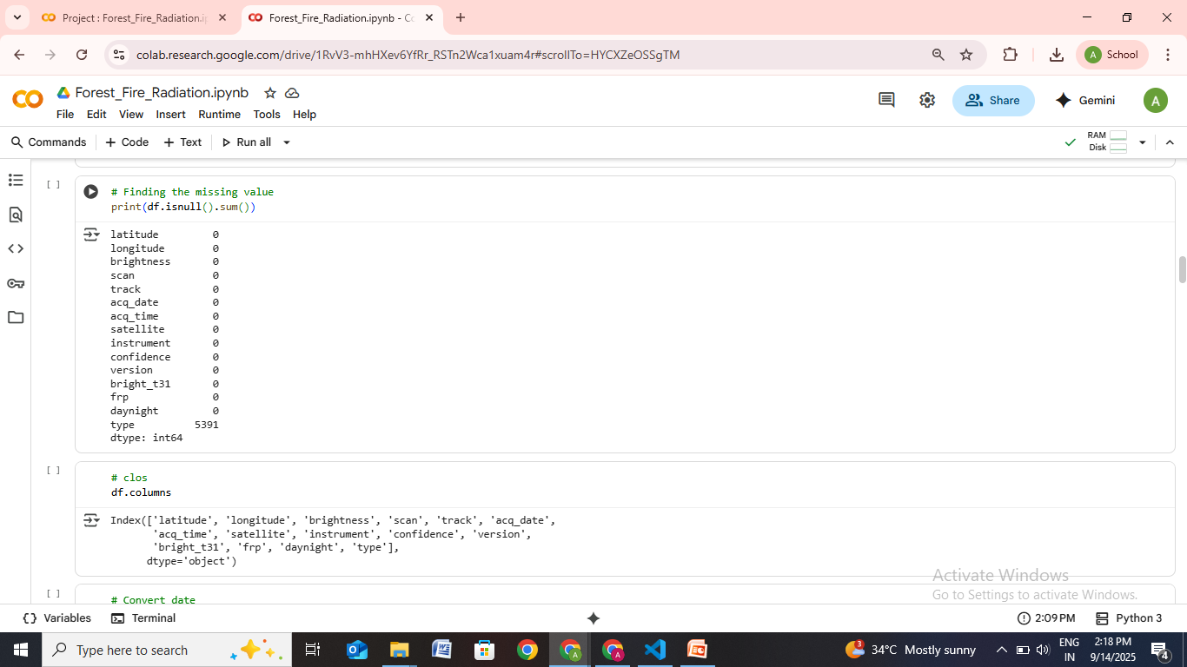
Screenshot of Output:

Slide 9
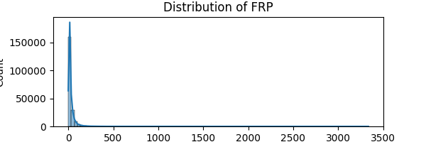
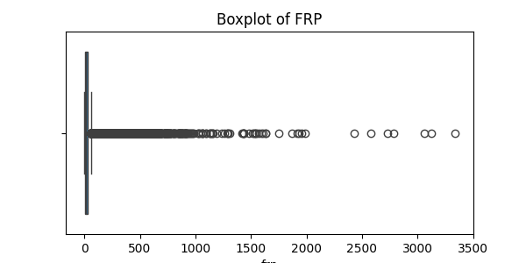
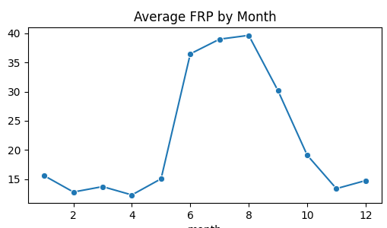
Exploratory Data Analysis (EDA)
Screenshot of Output:

Slide 10
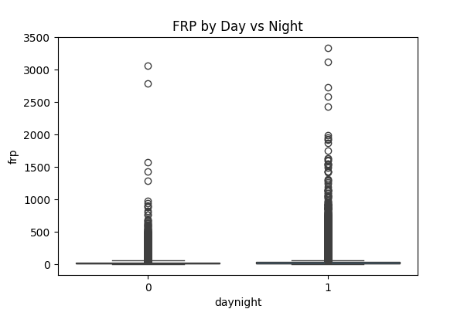
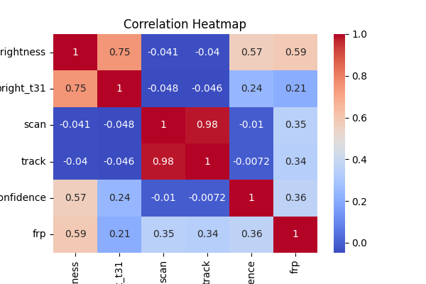
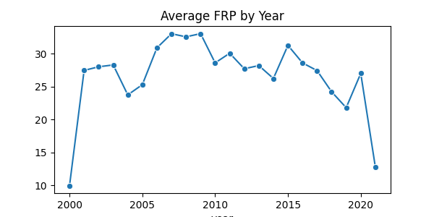
Screenshot of Output:

Slide 11
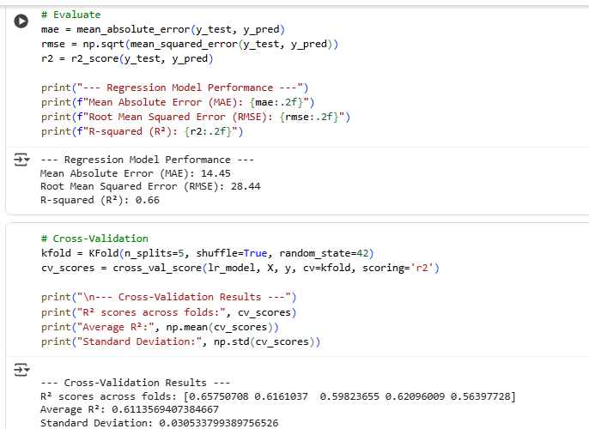
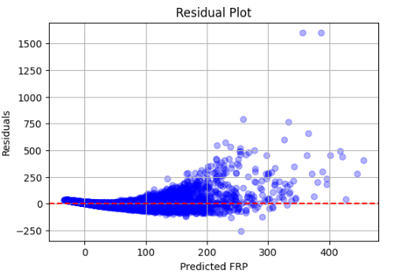
Screenshot of Output:
# Residual Analysis

Slide 12
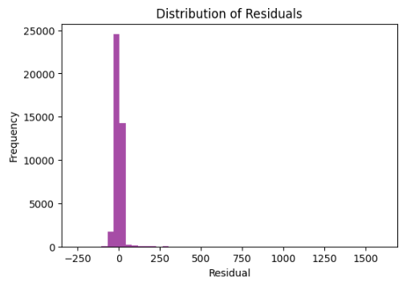
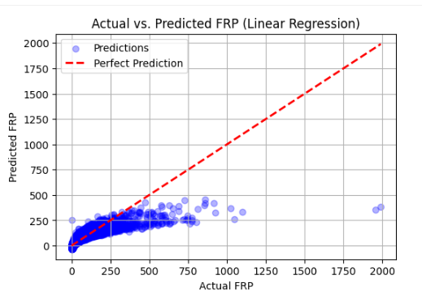
Screenshot of Output:
# Residual Analysis
# Actual vs Predicted Plot

Slide 13
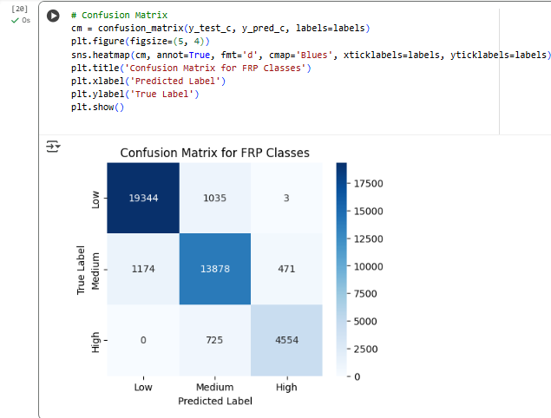
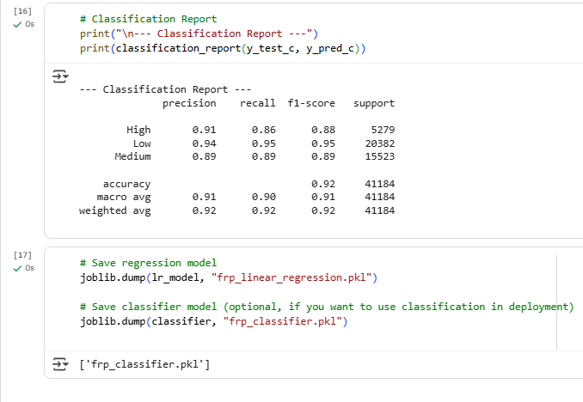
Screenshot of Output:

Slide 14
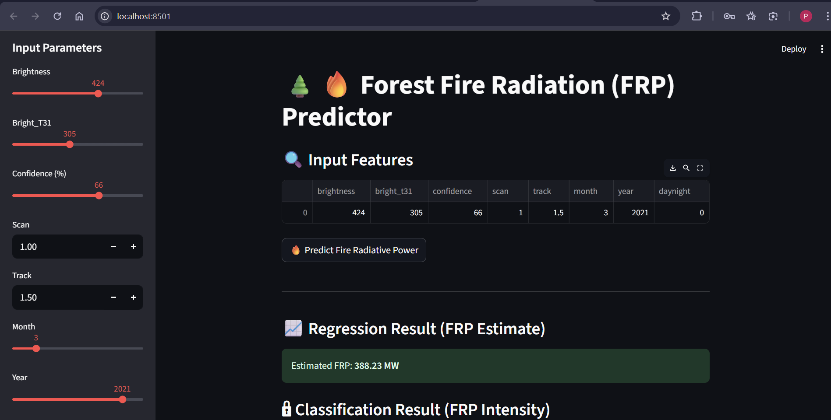
Deployment Interface
Screenshot of Output:

Slide 15
Conclusion:
The project is focused on estimating Fire Radiative Power (FRP) in forest fires using satellite data to support wildfire monitoring and management.
I approached the problem by preprocessing the dataset, performing exploratory data analysis (EDA), and applying two models: Linear Regression for predicting continuous FRP values and Logistic Regression for classifying FRP into intensity levels (Low, Medium, High).
The models were evaluated using MAE, RMSE, and R² for regression and accuracy, precision, recall, and F1-score for classification, along with cross-validation and residual analysis for reliability.
Impact: The project makes an impact by enabling early warning systems, improving disaster management, monitoring greenhouse gas emissions, and supporting policy planning through data-driven insights.
Future scope: Project can be expanded by using advanced machine learning techniques like Random Forests, Gradient Boosting, or Deep Learning models, integrating real-time satellite feeds, and extending to multiple regions for global wildfire prediction and management.

